Slide 1
Liquid Waste Management in Health Care Facilities
Wastewater Treatment Technologies
Mr. Krishna Ram Yendyo
CEO, EcoConcern Pvt. Ltd.

Slide 2
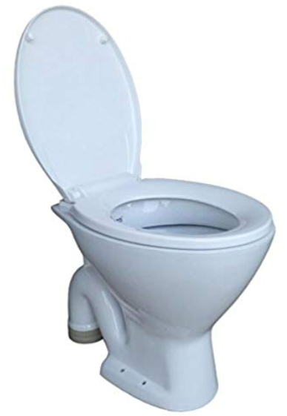
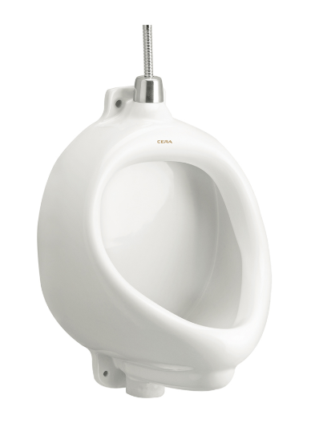
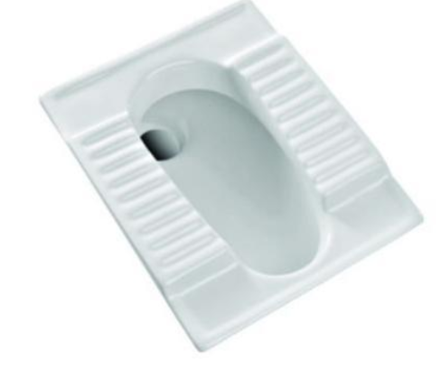
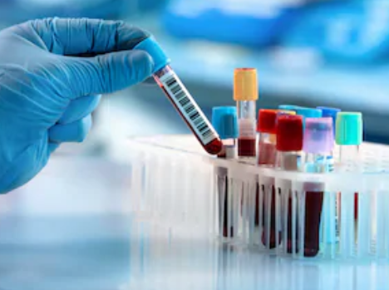
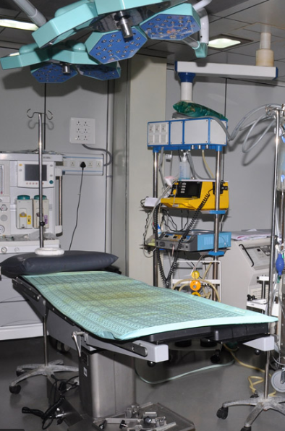
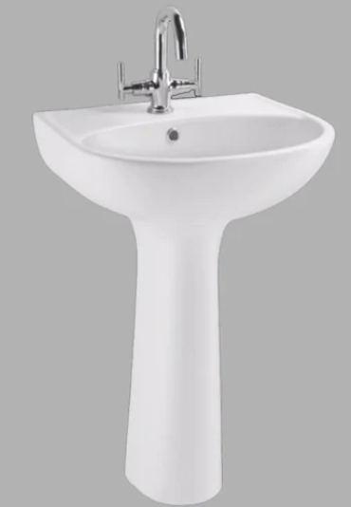
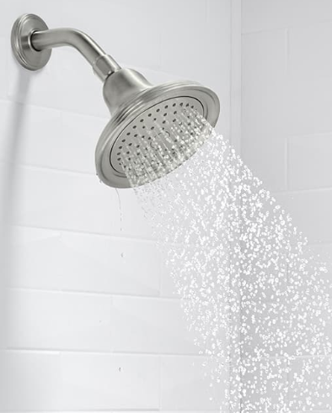
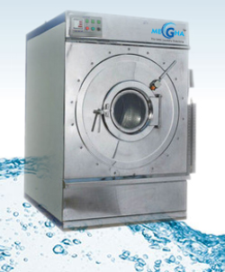
INTRODUCTION:
WATER BALANCE
RAIN
BLACK WATER
TOXIC WATER
CITY SUPPLY/BORING
GREY WATER
RAIN WATER
STORM WATER

Slide 3
INTRODUCTION:
RAIN
WASTEWATER
WATER BALANCE
BLACK WATER
TOXIC WATER
CITY SUPPLY/BORING
GREY WATER
RAIN WATER
STORM WATER

Slide 4
Characteristics of wastewater
BLACK WATER
GREY WATER
TOXIC WATER
High Organic
BOD 200-500
COD 650- 1400
TSS 180 -1000
Low Organic
BOD 80-150
COD 220-400
TSS 30-170
Photochemical
Disinfectants
Pharmaceuticals
Radioactive waste
Lab chemicals

Slide 5
Liquid Waste Treatment: Kathmandu Case
14 out of 16 hospitals do not treat their liquid waste before disposal.
hospitals who do ,do not test the treated effluent before disposal
Most hospitals discharge their liquid waste directly into municipal sewerage system without any pretreatment.

Slide 6
Risks from Health Care Facilities

Slide 7
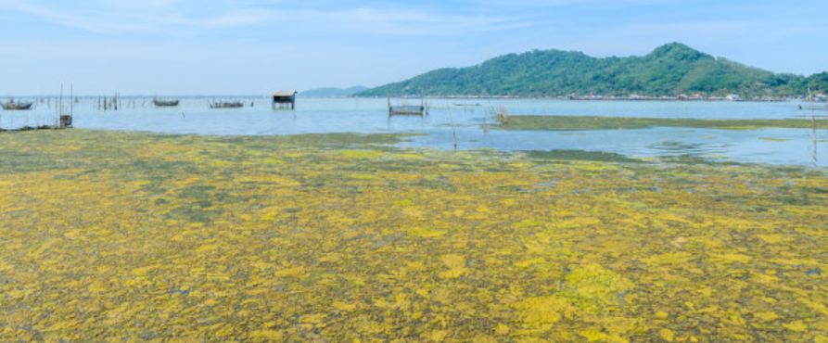
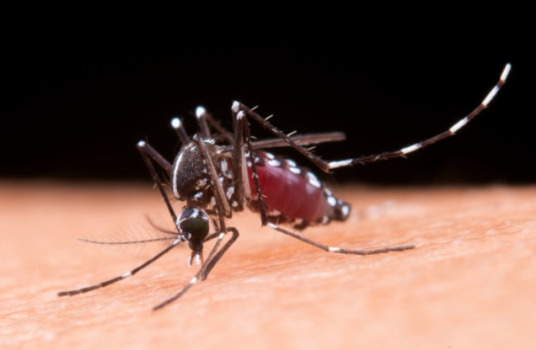
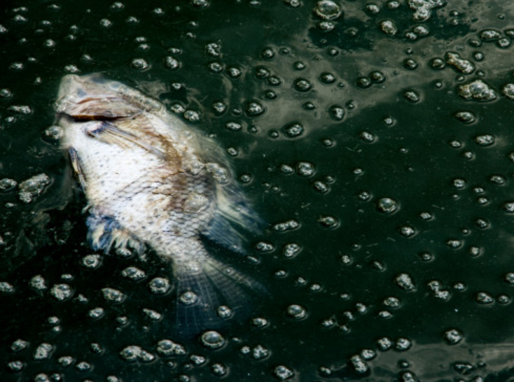
Implications
Environmental Implications:
Eutrophication ---- Algal Bloom
chemical & Pharmaceuticals …. Endocrine (or Hormone Disruptors)
Antibiotics – Antibiotic resistant pathogens
Mercury and Heavy Metals

Slide 8
Implications
Water-borne Diseases:
Cholera
Hepatitis A and E
Typhoid Fever
Diarrhoea
Giardiasis
Vector-borne Diseases:
Malaria
Encephalitis

Slide 9
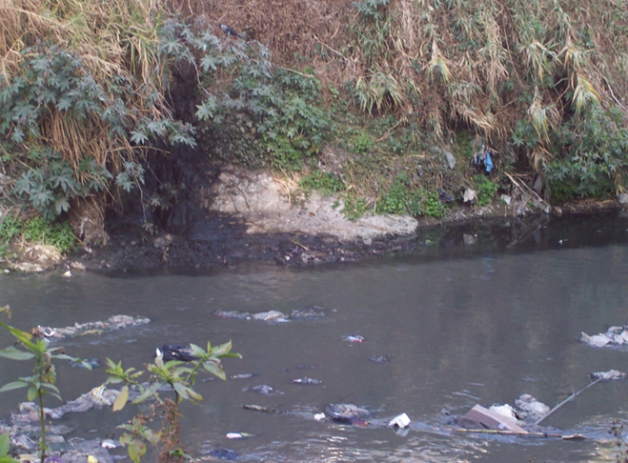
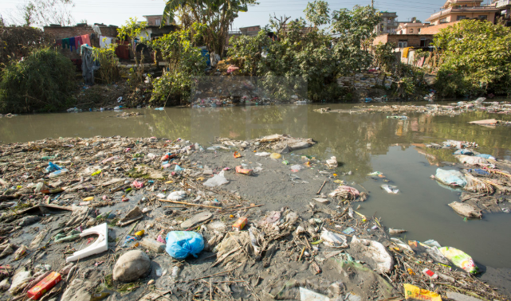
Implications
Aesthetics of City
Odour
Ugly Rivers
Absence of Aquatic Animals
Loss of water based recreations
Water Economy
Loss of Water Source
Loss of water Use
Unhealthy farm products
Loss of water civilization

Slide 10
Treatment Technology
CENTRALISED TREATMENT SYSTEM
DECENTRALIZED TREATMENT SYSTEM
OPD
OPD
SURGERY
CANTEEN
WWTP1
LAB
STAFF QUARTER
WASTEWATER TREATMENT PLANT
LAUNDRY
WWTP3
Radiology
LAB
EMERGENCY
WWTP2
Radiology
LAUNDRY

Slide 11
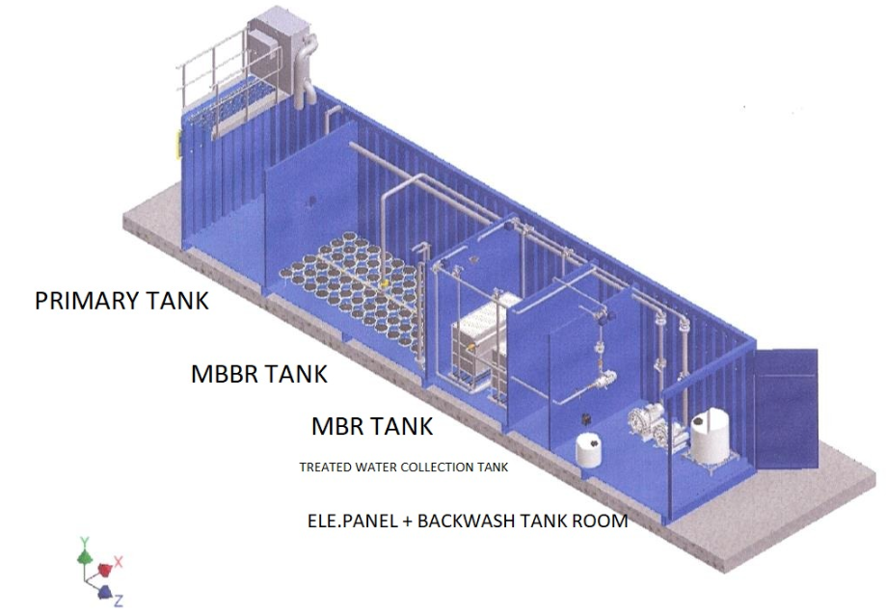
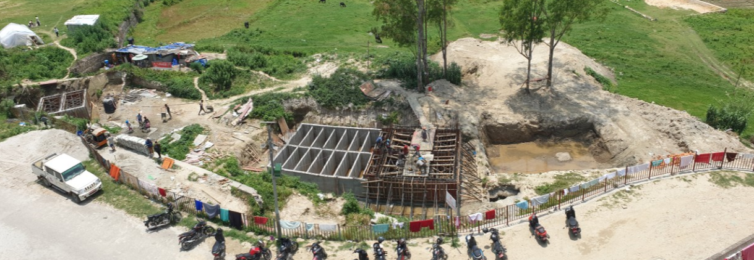
Treatment Technology
NATURAL TREATMENT SYSTEM
MECHANISED TREATMENT SYSTEM
Wastewater Treatment Plant for Dhulikhel Hospital
Proposed MBBR wastewater treatment plant for Urban Hospitals

Slide 12
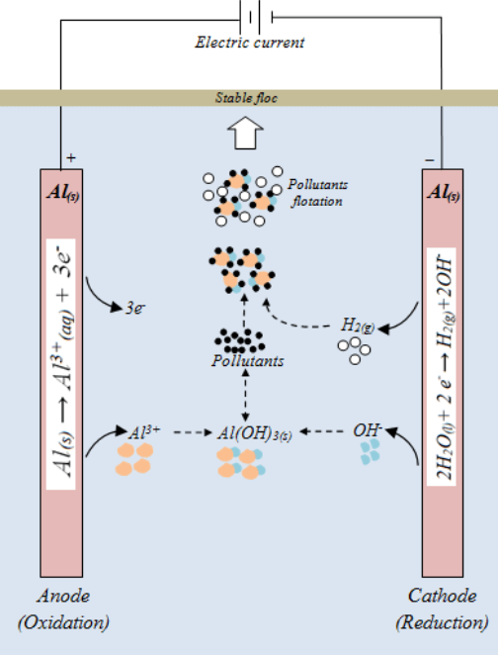
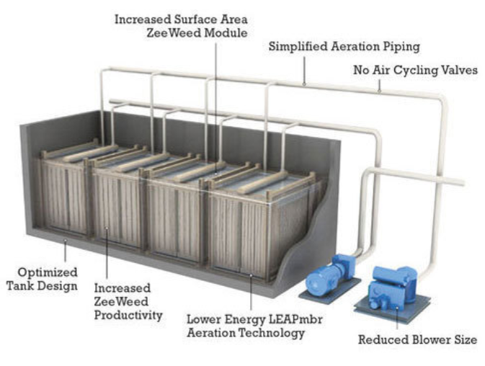
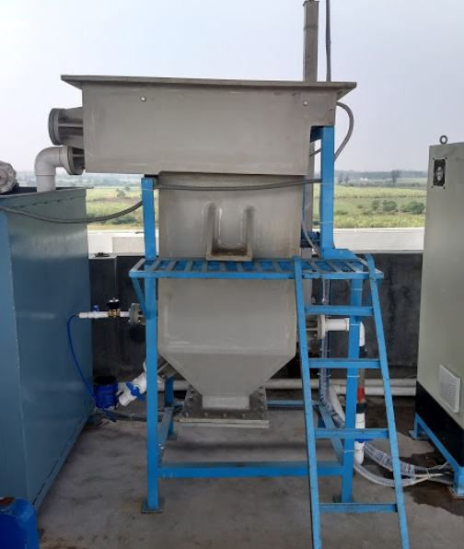
Treatment Technology: Toxic Wastewater
Acid-Base Neutralization, MBR Treatment Plant, EC Treatment Plant
Membrane Bioreactor (MBR) Treatment Plant
Electro-Coagulation

Slide 13
Wastewater Reuse in Hospital
Wastewater Segregation
End Use
Treatment Technologies
Greywater
Natural Treatment
Toilet Flushing
Black water
MBBR
Gardening
Toxic water
EC
Public Sewer

Slide 14
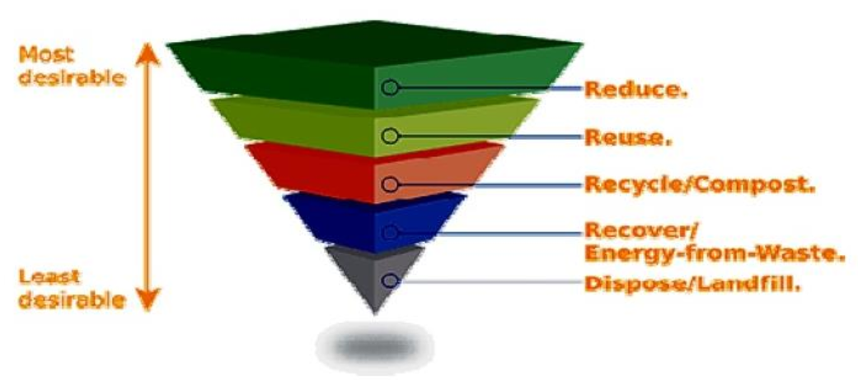
WAY FORWARD
SMART Treatment: Creating Business, Creating Employment, Creating Values
Adding Value to Hospital Management
Minimizing risk to public health
Protection of ambient environment

Slide 15
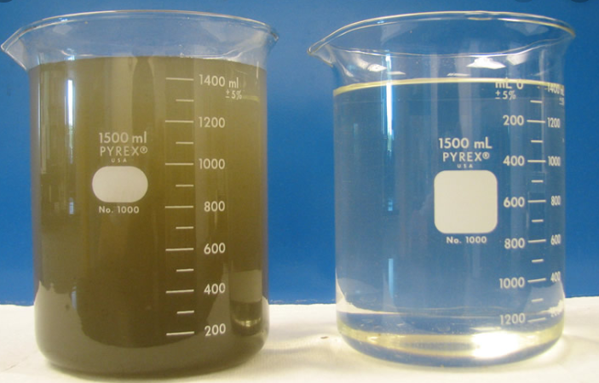
Lets treat hospital waste before it pollutes us
Contact:
Mr. Krishna Ram Yendyo
Krishna.yendyo@ecoconcern.com.np
+977 9841394378
(Wastewater treatment plant design and installation)
THANK YOU

